Slide 1
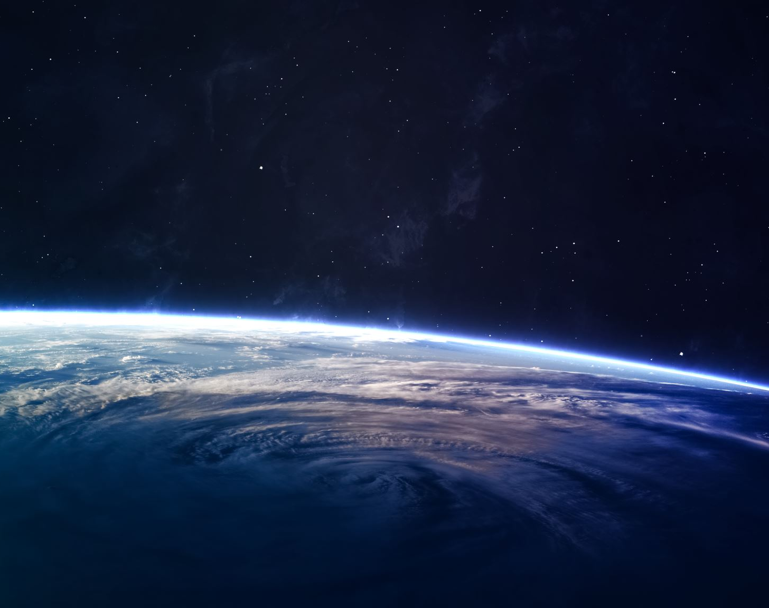
Elliptical of Mars
By: Kevin White

Slide 2
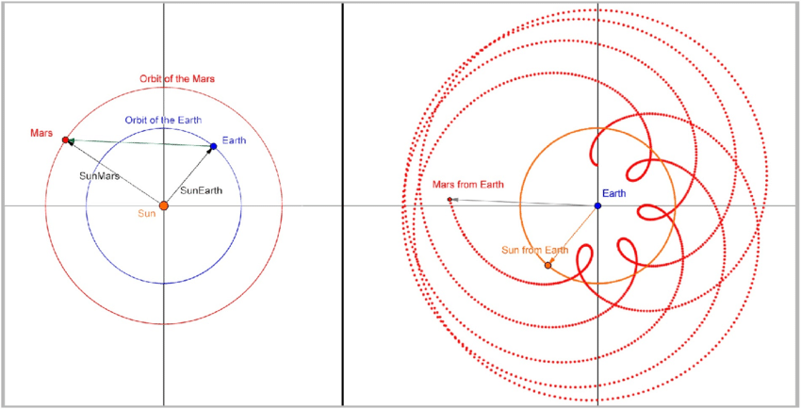
What Is An Elliptical Orbit?
Heliocentric
Geocentric
A Heliocentric mode of our solar system is the mode we usually think of when we can look at our solar system
A geocentric solar system mode puts earth at the center of our solar system and lets us graph Elliptical orbits of planets

Slide 3
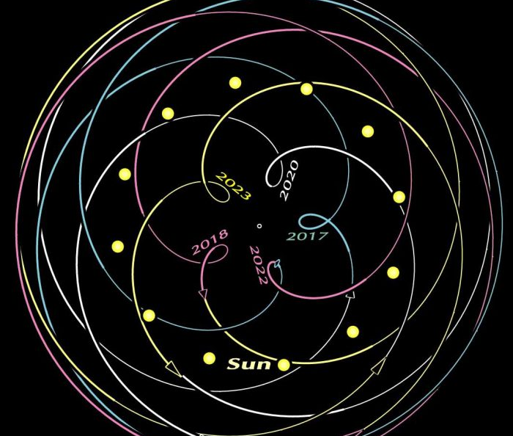
Purpose of Elliptical models
These Elliptical models can show relation of the earth and other planets over time.

Slide 4
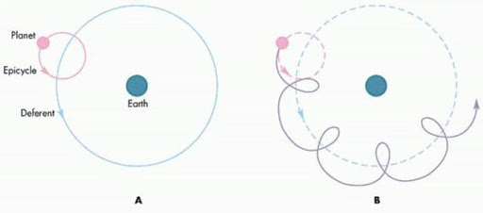
How do elliptical orbits work?
The Epicycle as seen on graph A shows how close the planet is related to earth and the Deferent on Graph A shows its distance through time. These to thing together make an elliptical. They are 2 circles that create a orbit just like the Faris wheel project.

Slide 5
Why the Loop?
When looking at the Elliptical model There is a loop where from the earths perspective the planet goes back on itself, this happens to all planets after earth In our solar system

Slide 6
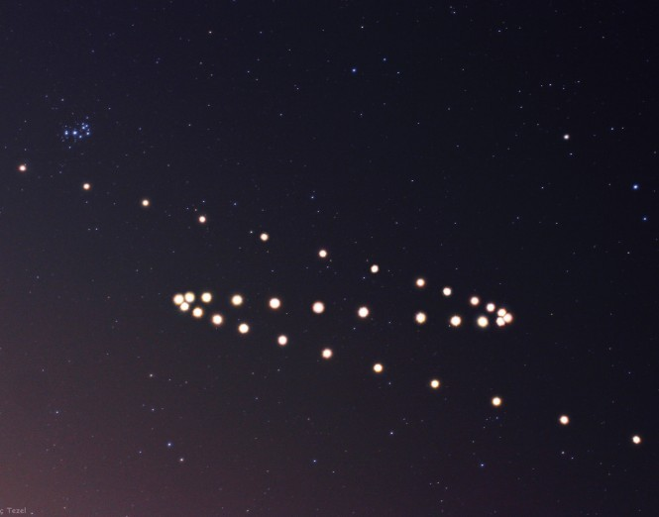
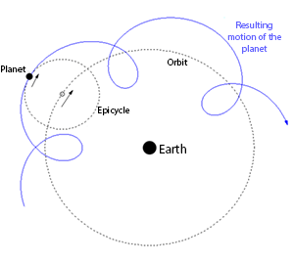
Retrograde
Elliptical graph
Real Life

